Slide 1

Title: Sales Data Analysis
Subtitle: Trends, Seasonality & Product Performance
Submitted By:
Name: Randhir Thakur
Enrollment No:- 23CSA2BC172
Submitted To:
Dr. Rakesh Sharma
Head of the Department, CSA

Slide 2
DATA ANALYTICS INTERSHIPS BY INTERN INFOBYTE
2.OBJECTIVE
Analyze sales data to identify overall trends.
Detect seasonal effects (monthly, quarterly, weekday patterns).
Evaluate performance of different products and categories.
Provide actionable business insights.

Slide 3
3.Dataset Overview
Source: Kaggle Superstore Dataset
Records: 9,994 transactions
Columns: Order Date, Sales, Product Name, Category, Sub‑Category, Profit, etc.
Time Period: 2015 – 2017

Slide 4
4. Methodology & Tools
Tools: Python (Pandas, Matplotlib, Seaborn), Jupyter Notebook, Excel
Steps:
Load data and clean (fix column names, convert dates)
Extract date features (Year, Month, Quarter, Weekday)
Analyze trends and seasonality
Evaluate product performance
Export key results to Excel

Slide 5
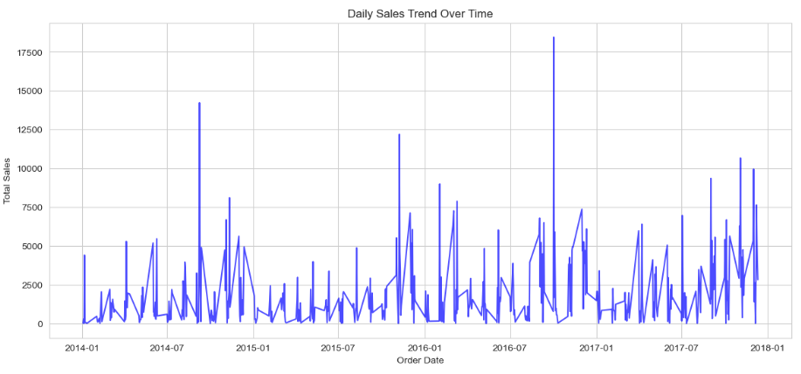
5.Overall Sales Trend
Title: Sales Trend Over Time
Key Observations:
Sales show a steady upward trend from 2015 to 2017.
Noticeable peaks in November and December (holiday season).
Insight: The business is growing year‑over‑year, with seasonal spikes.

Slide 6
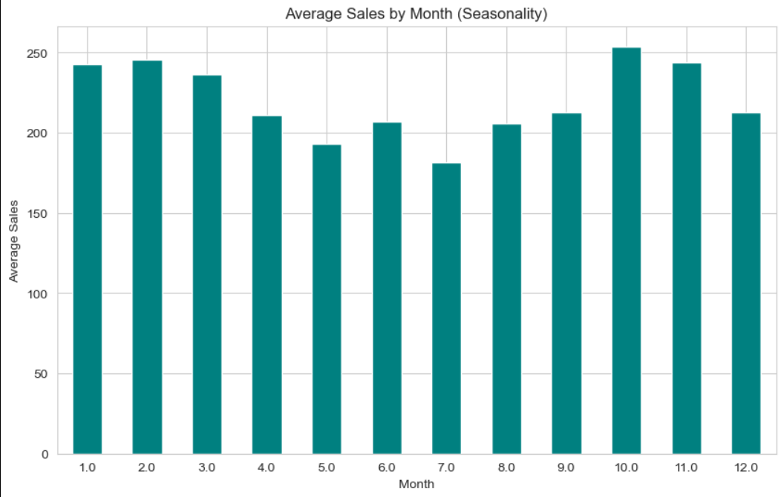
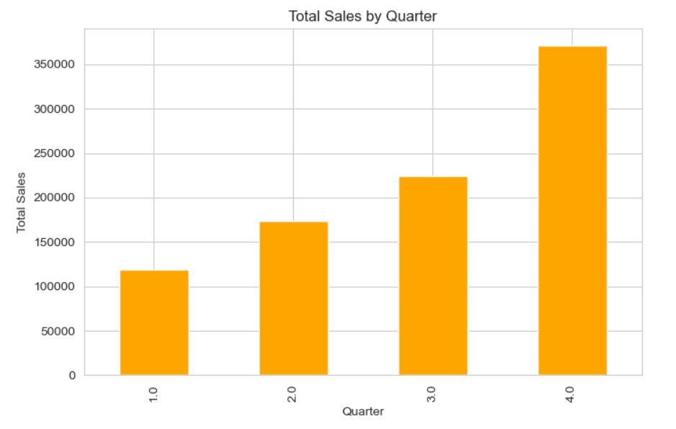
6.Seasonal Effects: Monthly & Quarterly
Title: Monthly & Quarterly Seasonality
Key Observations:
Highest average sales in November and December.
Q4 (Oct–Dec) contributes the most revenue.
Insight: Focus resources on Q4; consider promotions in slower months (Jan, Feb).

Slide 7
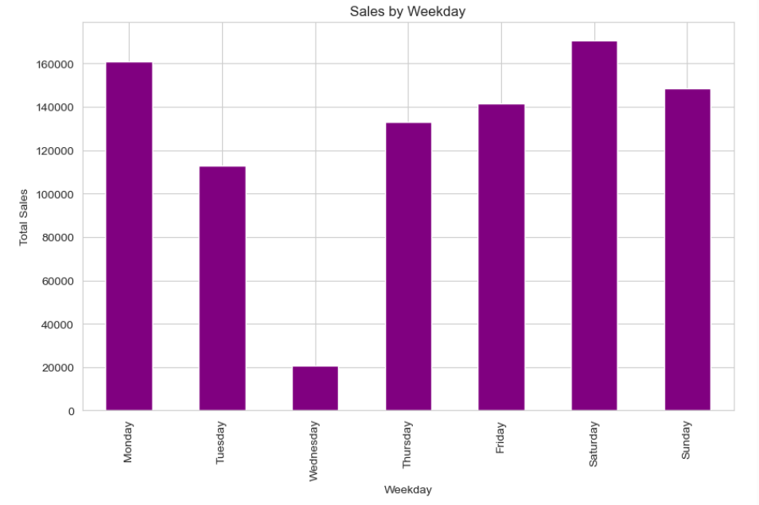
7.Seasonal Effects: Weekday Analysis
Title: Sales by Weekday
Key Observations:
Sales are relatively consistent across weekdays.
Slight peaks on Friday and Tuesday.
Insight: No extreme weekday fluctuations; marketing campaigns can be evenly distributed.

Slide 8
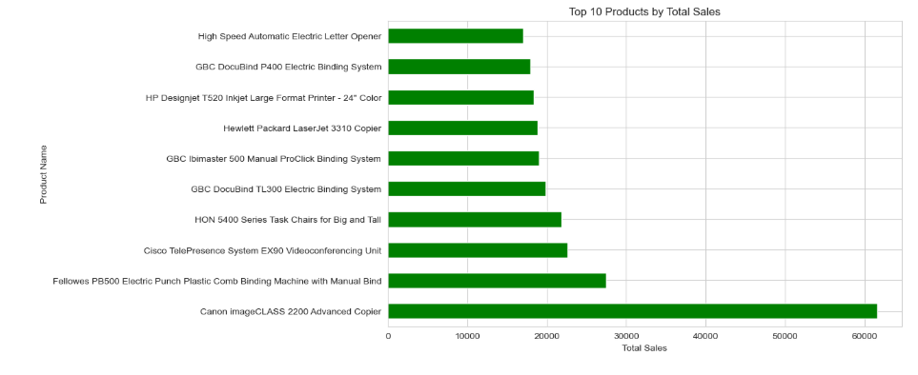
8.Product Performance: Top Products
Title: Top 10 Products by Sales
Key Observations:
Canon image CLASS 2200 Advanced Copier is the top seller.
Most top products belong to the Technology category.
Insight: Focus inventory and promotions on these high‑performing products.

Slide 9
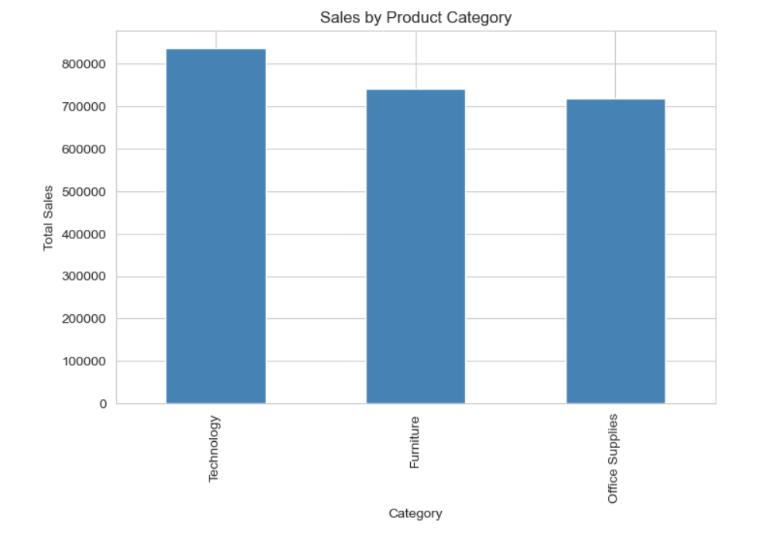
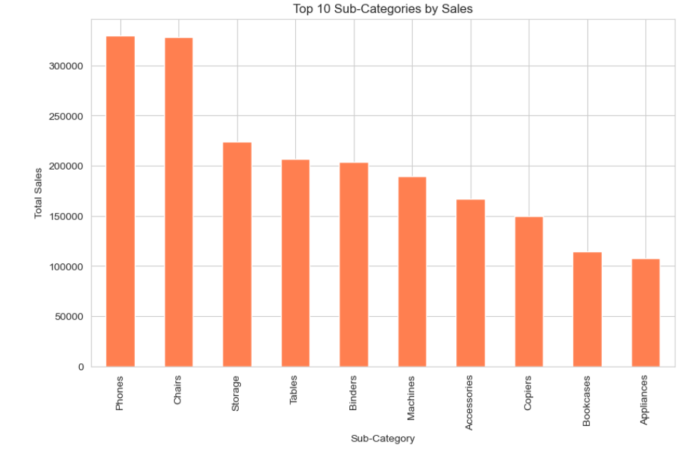
9.Category & Sub‑Category Performance
Title: Category & Sub‑Category Analysis
Key Observations:
Technology category leads with over 40% of total sales.
Phones, Chairs, and Storage are the top sub‑categories.
Insight: Investing in Technology could drive further growth.

Slide 10
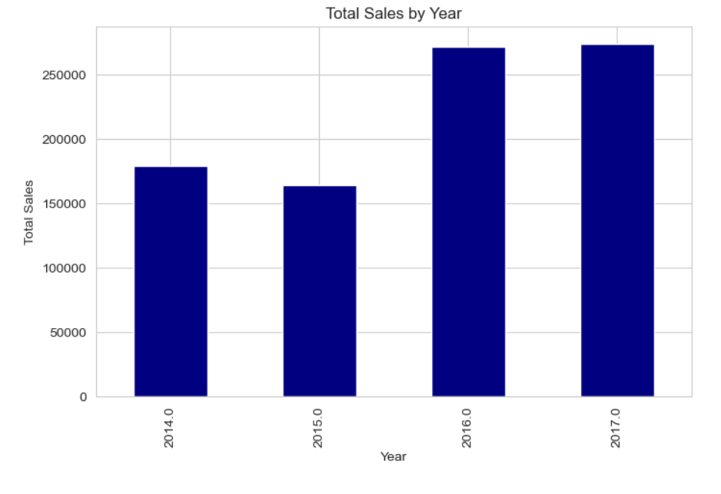
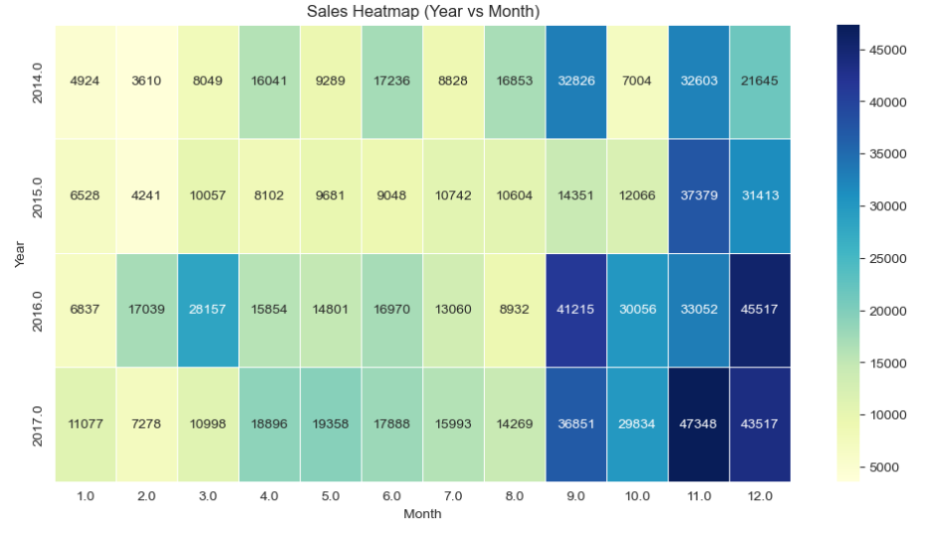
10.Additional Insights
Title: Year‑over‑Year & Heatmap
Key Observations:
Sales grew each year (2015 → 2016 → 2017).
Heatmap confirms strong Q4 performance every year.
Insight: The upward trend is consistent; Q4 should be prioritized for resource allocation.

Slide 11
11.Conclusion & Recommendations
Content:
Summary:
Sales have grown steadily, driven by Q4 holiday demand.
Technology products (especially phones and copiers) are the revenue drivers.
Weekdays show no major variation; monthly peaks are in Nov/Dec.
Recommendations:
Inventory: Stock up on top products before Q4.
Promotions: Run campaigns in low‑sales months (Jan, Feb) to smooth revenue.
Category focus: Expand Technology category offerings.
Profitability: Review profit margins to ensure high‑revenue items are also profitable.

Slide 12
THANK YOU!

